Slide 1
Active Machine Learning (ML) & Agency
Bayesian optimization
Danmarks Tekniske Universitet
Eksamen forår 2021
02463
Alexander
Valentini
S194252

Slide 2
Active ML & Agency Bayesian optimization (Q1)
Gaussian processes
Danmarks Tekniske Universitet
Eksamen forår 2021
02463
Alexander
Valentini
S194252

Slide 3
Active ML & Agency (Q1) Bayesian optimization - Gaussian processes
Role of covariance functions in Gaussian processes
Also known as the the kernel function, they is used to create the covariance matrix for our X and similarity between datapoints
Given our data is a multivariate Gaussian distribution we can use the kernel function to find the distribution posterior distribution of our function values:
$$p\left(y_{∗}|D,x_{∗}\right)=p\left(y_{∗}|y,X,x_{∗}\right)=𝒩(x_{y∗|y},\sum_{y∗|y}{)}$$
$$μ_{y∗|y}=μ\left(X_{∗}\right)+K\left(X,X_{∗}\right){\left[K\left(X,X\right)+σ_{n}^{2}I\right]}^{−1}\left(y−μ\left(X\right)\right)$$
$$\sum_{y∗|y}{=K\left(X_{∗},X_{∗}\right)−K\left(X_{∗},X\right)}{\left[K\left(X,X\right)+σ_{n}^{2}I\right]}^{−1}K\left(X,X_{∗}\right)$$
Therefore the covariance matrix determines the characteristics of the function we want to predict.
Another important assumption is the smoothness assumption, such that:
$x_{i}≈x_{j}⟹$ $y_{i}≈y_{j}$
02463
Alexander
Valentini
S194252
Gaussian Processes by Federico Bergamin & Kristoffer H. Madsen (3.4.3)(29) with equations above

Slide 4
Active ML & Agency (Q1) Bayesian optimization - Gaussian processes
Role of covariance functions in Gaussian processes
For Gaussian Processes the covariance matrix is generated pairwise on points by evaluating a kernel function, and this is also often called covariance function.
(18)+(19)
$$\sum_{i,j}{}=\operatorname{Cov}\left(y_{i},y_{j}\right)=k\left(x_{i},x_{j}\right)=σ^{2}\exp\left(−\frac{{\left\|x_{i}−x_{j}\right\|}^{2}}{2l^{2}}\right)+{δ_{ij}σ}_{noise}^{2}$$
Lengthscale l describes how smooth a function is (wiggle). Determines how far out points influence the distribution of other points.
Signal variance $σ^{2}$ - is the output variance and scaling factor. It determines variation of function values from their mean. Small value of σ2 characterize functions that stay close to their mean value.
Noise variance $σ_{noise}^{2}$ is the variance of noise that apply to identical datapoints, if present.
02463
Alexander
Valentini
S194252
Gaussian Processes by Federico Bergamin & Kristoffer H. Madsen (3.4)(19)

Slide 5
Active ML & Agency (Q1) Bayesian optimization - Gaussian processes
Role of covariance functions in Gaussian processes
For Gaussian Processes the covariance matrix is generated pairwise on points by evaluating a kernel function, and this is also often called covariance function.
02463
Alexander
Valentini
S194252
Gaussian Processes by Federico Bergamin & Kristoffer H. Madsen (3.4)(19)

Slide 6
Active ML & Agency (Q1) Bayesian optimization - Gaussian processes
The distribution when conditioning on variables in a Gaussian distribution
An important property of the Gaussian distribution is that its conditional and marginal distribution are still Gaussian.
Allows us to express distribution of function value in closed form
We are interested in directly modelling our targets y* instead of committing to a specific parameter model. We want to know the distribution p(y*|D,x*)
Technicalities:
$$𝒩\left(x | μ,Σ\right)=\frac{1}{{\left(2π\right)}^{D/2}}\frac{1}{{\left|Σ\right|}^{1/2}}\exp{(−\frac{1}{2}{\left(x−μ\right)}^{T}Σ^{−1}\left(x−μ\right))}$$
$p\left(x_{a}\right)=𝒩\left(x_{a} | μ_{a},Σ_{aa}\right)$, $p\left(x_{b}\right)=𝒩\left(x_{b} | μ_{b},Σ_{bb}\right)$,
$$p\left(x_{a}|x_{b}\right)=𝒩\left(x | μ_{a|b},Σ_{a|b}\right)$$
$$μ_{a|b}=μ_{a}+Σ_{ab}Σ_{bb}^{−1}(x_{b}−μ_{b})$$
$$Σ_{a|b}=Σ_{aa}−Σ_{ab}Σ_{bb}^{−1}Σ_{ba}$$
02463
Alexander
Valentini
S194252
Gaussian Processes by Federico Bergamin & Kristoffer H. Madsen (afsnit 2)(5)
http://www.math.chalmers.se/~rootzen/highdimensional/SSP4SE-appA.pdf

Slide 7
Active ML & Agency Bayesian optimization (Q2)
acquisition & covariance
Danmarks Tekniske Universitet
Eksamen forår 2021
02463
Alexander
Valentini
S194252

Slide 8
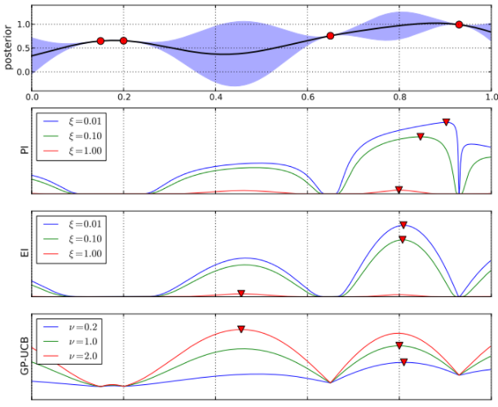
Aktiv ML & Agency (Q2) Bayesian optimization - acquisition & covariance
Acquisition function in Bayesian optimization
BO maintains a probabilistic belief about f and designing a so called acquisition function to determine, where to evaluate the function next. Bayesian optimization is well-suited to global optimization of expensive black-box function f.
- used when we wish to optimize a function f - GP is often used as probabilistic function.
Acquisition functions
determine "value" of evaluating point
accounts for uncertainty of the function
with free parameter that trades of exploitation/exploration
02463
Alexander
Valentini
S194252

Slide 9
Aktiv ML & Agency (Q2) Bayesian optimization - acquisition & covariance
Optimizing covariance function parameters
When doing Gaussian Processes we use the covariance function – also called Kernel function K=K(X,X). We need to find a way to select hyperparameters
(18)+(19)
$$\sum_{i,j}{}=\operatorname{Cov}\left(y_{i},y_{j}\right)=k\left(x_{i},x_{j}\right)=σ^{2}\exp\left(−\frac{{\left\|x_{i}−x_{j}\right\|}^{2}}{2l^{2}}\right)+{δ_{ij}σ}_{noise}^{2}$$
Lengthscale l describes how smooth a function is. Small lengthscale value means that function values can change quickly, large values characterize functions that change only slowly. Lengthscale also determines how far we can reliably extrapolate from the training data
Signal variance $σ^{2}$ is a scaling factor. It determines variation of function values from their mean. Small value of σ2 characterize functions that stay close to their mean value. If the signal variance is too large, the modelled function will be free to chase outliers.
Noise variance $σ_{noise}^{2}$ is formally not a part of the covariance function itself. It is used by the Gaussian process model to allow for noise present in training data. This parameter specifies how much noise is expected to be present in the data.
02463
Alexander
Valentini
S194252
Gaussian Processes by Federico Bergamin & Kristoffer H. Madsen (3.4)(19)

Slide 10
Aktiv ML & Agency (Q2) Bayesian optimization - acquisition & covariance
Optimizing covariance function parameters
One way to optimize is to use the log likelihood of the training data:
$$\log{p(y|X)}=\log{𝒩\left(y | 0,K+σ_{n}^{2}I\right)}=−\frac{1}{2}y^{T}{\left[K+σ_{n}^{2}I\right]}^{−1}y−\frac{1}{2}\log\left|K+σ_{n}^{2}I\right|−\frac{N}{2}\log{(2π)}$$
When having few point, the optimization process might try to explain the points using the noise variance, resulting in a straight line (with a slope) as the lengthscale is high.
Solution is to either optimize lengthscale and output variance while the noise variance is fixed to a very small value or we apply a prior on the value of the lengthscale. We factor this prior assumption into our optimization.
$$\left\{l,o,n\right\}∈\arg{\max_{l,o,n}{\{\sum_{i=1}^{n}{\left[\log{p\left(D_{i} | l,o,n\right)}\right]+\log{p(l)}}\}}}$$
02463
Alexander
Valentini
S194252
Gaussian Processes by Federico Bergamin & Kristoffer H. Madsen p.17 (3.4.5)(33) and after (36) with equations above

Slide 11
Active ML & Agency Bayesian optimization (Q3)
goal & improvements
Danmarks Tekniske Universitet
Eksamen forår 2021
02463
Alexander
Valentini
S194252

Slide 12
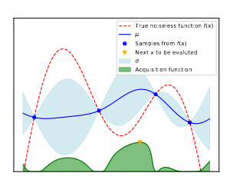
Active ML & Agency (Q3) Bayesian optimization – goal & improvements
Main goal of Bayesian optimization
The main goal of BO is to find the optimum of some objective function.
BO is useful when the target function is costly to evaluate and/or when gradients/symbolic-forms of the function are unknown (Black box function)
Bayesian optimization for function f proceeds by maintaining a probabilistic belief about f and designing a so called acquisition function to determine, where to evaluate the function next. Bayesian optimization is well-suited to global optimization of expensive black-box function f
02463
Alexander
Valentini
S194252

Slide 13
Active ML & Agency (Q3) Bayesian optimization – goal & improvements
Expected improvement acquisition function
We are interested in sampling the point with the largest expected improvement.
Incorporates cumulative function and probability density function.
EI is defined as:
$$EI\left(x\right)=𝔼 \left[\max_{x}{(0,f_{t+1}\left(x\right)−f\left(x^{+}\right))}\right]$$
Probability of improvement is used and defined as:
$$PI\left(x\right)=Φ\left(\frac{μ\left(x\right)−f\left(x^{+}\right)−ξ}{σ\left(x\right)}\right)$$
$$EI\left(x\right)=\left\{\begin{matrix}\left(μ\left(x\right)−f\left(x^{+}\right)\right)Φ\left(Z\right)+σ\left(x\right)φ\left(Z\right), if σ\left(x\right)>0 \\ 0, if σ\left(x\right)≤0\end{matrix}\right.$$
02463
Alexander
Valentini
S194252
Bayesian Optimization BY Federico Bergamin & Kristoffer H. Madsen (2.2.1)(9)+(10)+(2.2.2) (17)

Slide 14
Active ML & Agency Bayesian optimization (Q4)
trade-off & acquisition func
Danmarks Tekniske Universitet
Eksamen forår 2021
02463
Alexander
Valentini
S194252

Slide 15
Active ML & Agency (Q4) Bayesian optimization – trade-off & acq. function
Trade-off between exploration & exploitation
This acquisition function, will result in mostly exploitation and no exploration. We will always prefer points with high probability of being infinitesimally grater then the current best samples $f\left(x^{+}\right)$ over points that are less certain. To overcome this drawback, we add a trade-off parameters ξ ≥ 0 that has to trade-off exploration and exploitation. This probability of improvement acquisition function is defined as:
$$PI\left(x\right)=Φ\left(\frac{μ\left(x\right)−f\left(x^{+}\right)−ξ}{σ\left(x\right)}\right)$$
Annealing heuristic for ξ suggest value of ξ as initially high in order to have preference on exploration and then gradually decreased towards 0 to later prefer exploitation.
02463
Alexander
Valentini
S194252
Bayesian Optimization BY Federico Bergamin & Kristoffer H. Madsen (2.2.1)(10)

Slide 16
Active ML & Agency (Q4) Bayesian optimization – trade-off & acq. function
Trade-off between exploration & exploitation
Exploration – We search unexplored areas and values. Exploration is crucial to achieve high reward in the long term, better values can be found
Exploitation: Focusing function evaluations around the current best results. Higher rewards in the very short term
Important in BO as we would like to find optimum value
IPA example
02463
Alexander
Valentini
S194252

Slide 17
Active ML & Agency (Q4) Bayesian optimization – trade-off & acq. function
(max) probability of improvement acquisition function
$$PI\left(x\right)=P\left(f\left(x\right)≥f\left(x^{+}\right)\right)$$
where $f\left(x^{+}\right)$ is the value of the best sample so far and $x^{+}$ is the location of that sample
probability of improvement acquisition function
$$PI\left(x\right)=Φ\left(\frac{μ\left(x\right)−f\left(x^{+}\right)−ξ}{σ\left(x\right)}\right)$$
This acquisition function, will result in mostly exploitation and no exploration. We will always prefer points with high probability of being infinitesimally grater then the current best samples $f\left(x^{+}\right)$ over points that are less certain. Therefore we add a trade off parameter $ξ$
02463
Alexander
Valentini
S194252
Bayesian Optimization BY Federico Bergamin & Kristoffer H. Madsen (2.2.1) (5) (9)

Slide 18
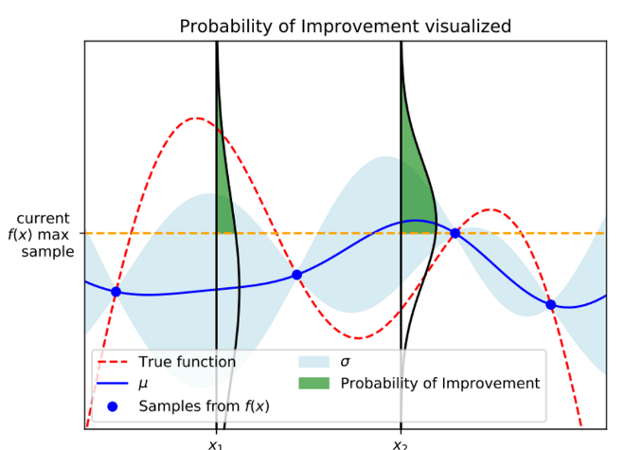
Active ML & Agency (Q4) Bayesian optimization – trade-off & acq. function
02463
Alexander
Valentini
S194252

Slide 19
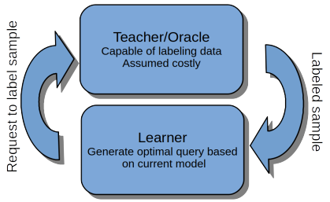
Active Machine Learning (ML) & Agency
Active learning
Danmarks Tekniske Universitet
Eksamen forår 2021
02463
Alexander
Valentini
S194252

Slide 20
Active ML & Agency Active learning (Q5)
Sampling, synthesis & entropy
Danmarks Tekniske Universitet
Eksamen forår 2021
02463
Alexander
Valentini
S194252

Slide 21
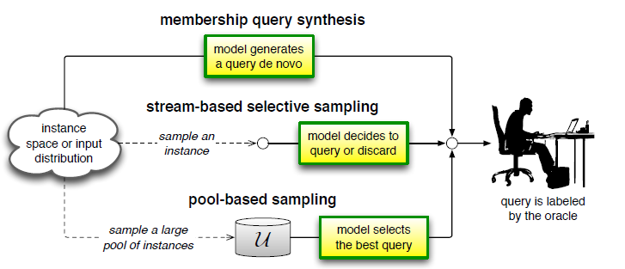
Active ML & Agency (Q5) Active learning – Sampling, synthesis & entropy
Distinction between
pool-based sampling
stream-based selective sampling
query membership synthesis
02463
Alexander
Valentini
S194252

Slide 22
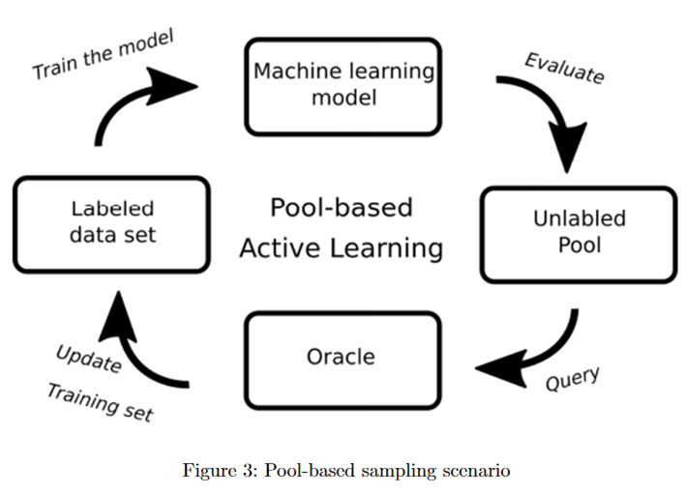
Active ML & Agency (Q5) Active learning – Sampling, synthesis & entropy
02463
Alexander
Valentini
S194252

Slide 23
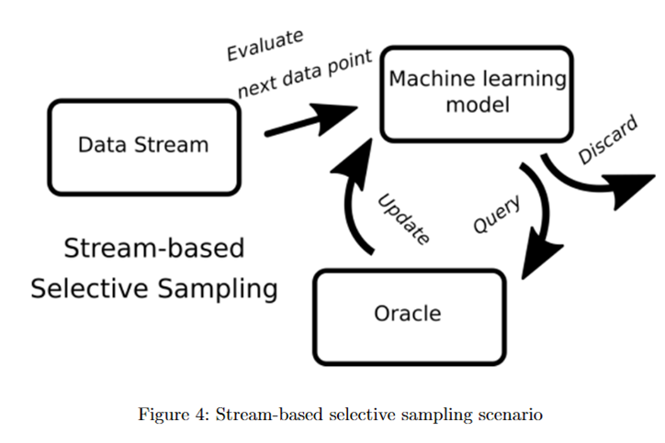
Active ML & Agency (Q5) Active learning – Sampling, synthesis & entropy
02463
Alexander
Valentini
S194252

Slide 24
Active ML & Agency (Q5) Active learning – Sampling, synthesis & entropy
Generate synthetic datepoints from whole input space
02463
Alexander
Valentini
S194252

Slide 25
Aktiv ML & Agency (Q5) Active learning – Sampling, synthesis & entropy
How entropy can quantify information of a categorical variable
Measure of information gain is the Shannon information content of an event x from a random variable X, which is defined as h(x) and entropy as H(x):
$$h(x)=\log{\frac{1}{p(x)}}$$
$$H\left(X\right)=−\sum_{x∈H}{p\left(x\right)∙\log{p(x)}}$$
Entropy is used to evaluate information gain when sampling a point. We can reduce version space. A good example is an unbiased and biased coin toss
$$H\left(X\right)=\frac{1}{2}\log_{2}\left(\frac{1}{\frac{1}{2}}\right)+\frac{1}{2}\log_{2}\left(\frac{1}{\frac{1}{2}}\right)=1 bit$$
$$H\left(X\right)=0.2\log_{2}\left(\frac{1}{0.2}\right)+0.8\log_{2}\left(\frac{1}{0.8}\right)=0.72 bit$$
Weighted with the outcome probability. We gain more information from rare events, but the probability that they will have that label is low
02463
Alexander
Valentini
S194252
Active Learning Lecture Notes - Philip J. H. Jørgensen & Kristoffer H. Madsen (2.1) (2.2) +fig(3) (4) (5)

Slide 26
Active ML & Agency Active learning (Q6)
Uncertainty quantification & margin sampling
Danmarks Tekniske Universitet
Eksamen forår 2021
02463
Alexander
Valentini
S194252

Slide 27
Active ML & Agency (Q6) Active learning – Uncertainty & sampling
Role of uncertainty quantification in active learning
Active learning has some resemblances to BO, but the objective is to reduce
uncertainty of our learning scheme.
Gain as much information as possible.
In this setting, the most informative unlabelled data points are defined as the ones which he model is most uncertain on how to label.
Three main ways to quantify uncertainty:
Least confident, margin and entropy
02463
Alexander
Valentini
S194252

Slide 28
Active ML & Agency (Q6) Active learning – Uncertainty & sampling
Margin sampling is a strategy for uncertainty sampling and expressed by:
$$x^{∗}=\underset{x∈U}{argmin}{p_{θ}(y_{\left(1\right)}|x)−p_{θ}(y_{\left(2\right)}|x)}$$
where the notation $y_{\left(1\right)}$ and $y_{\left(2\right)}$ is borrowed from order statistics denote the most and second most likely label of x respectively.
Here the data point with the smallest difference between the two most likely labels will be chosen for the next query. Margin sampling takes the probability of the second most likely label into account but still ignores all the remaining labels.
So if the problem consist of a large set of labels Y much of the information of the label distribution is still not included in the query decision. For a small number of labels, margin sampling it performs well though.
Idea is that it is difficult do classify if the two largest labels have similar probability
02463
Alexander
Valentini
S194252
Active Learning Lecture Notes - Philip J. H. Jørgensen & Kristoffer H. Madsen(3.14)

Slide 29
Active ML & Agency Active learning (Q7)
Learning strategy & models
Danmarks Tekniske Universitet
Eksamen forår 2021
02463
Alexander
Valentini
S194252

Slide 30
Active ML & Agency (Q7) Active learning – Learning strategy & models
How an active learning strategy can be more effective than passive learning
In real-life scenarios, data annotation can be quite costly (e.g. requiring expert knowledge or very time consuming) which puts a budget on the amount of data that is feasible to train a learner on
We are therefore interested in selecting the data that yields the best possible learningoutcome, and active learning provides methods to select this data.
Passive learning:The learner is only trained on a ”static” collection of data that
has been fully annotated/labelled with no regards to its usefulness in terms of the learner. Assumes data is sufficient to find a good score.
The extra steps of evaluating the confidence of predicting the labels for new data and querying a teacher for labels are why active learning extends beyond the usual passive learning
02463
Alexander
Valentini
S194252

Slide 31
Active ML & Agency (Q7) Active learning – Learning strategy & models
Idea behind active learning based on expected impact/expected model change
Use methods to estimate the expected improvement of some objective for the model achieved by labelling an unlabeled data point.
The most informative points do not always improve the function the most.
Three main ideas – gradient length, error minimization and entropy minimization
02463
Alexander
Valentini
S194252

Slide 32
Active ML & Agency Active learning (Q8)
Entropy & strategy
Danmarks Tekniske Universitet
Eksamen forår 2021
02463
Alexander
Valentini
S194252

Slide 33
Active ML & Agency (Q8) Active learning – Entropy & strategy
Concept of entropy
$$H(X)=\sum_{x∈A_{x}}{P\left(x\right)∙\log{\frac{1}{P(x)}}}$$
Based on Shannons information content
One way to look at uncertainty in a set of predictions is by whether you expect to be surprised by the outcome. This is the concept behind entropy: how surprised would you be each of the possible outcomes, relative to their probability? A good example is coin toss. We express information gain in bits (with log2). We weight the information gain with its probability. Entropy sampling considered most general
$$x^{∗}=\underset{x∈U}{argmax}{−\sum_{y∈Y}{p_{θ}\left(y|x\right)∙\log{p_{θ}\left(y|x\right)}}}$$
Largest entropy with uniform probability distribution
Same as:
$$x^{∗}=\underset{x∈U}{argmax}{\sum_{y∈Y}{p_{θ}\left(y|x\right)∙\log{\frac{1}{p_{θ}\left(y|x\right)}}}}$$
02463
Alexander
Valentini
S194252
Active Learning Lecture Notes - Philip J. H. Jørgensen & Kristoffer H. Madsen (2.2) (3.15)

Slide 34
Active ML & Agency (Q8) Active learning – Entropy & strategy
Query-by-Committee strategy & potential (dis)advantages
Disagreement can be measured with Vote entropy, Kullback-Leibler divergence or
Consensus probability. We approximate our version space with our learners. Bagging
+ Quite simple, can be used with any learning algorithm
+ Better generalization of uncertainty, often converges to better performance (seen) in project. Like an ensemble model.
- Needs more training as model is more complex. If some learners are complex
02463
Alexander
Valentini
S194252
- It can be complex to set up several committee members with low amount of training data.

Slide 35
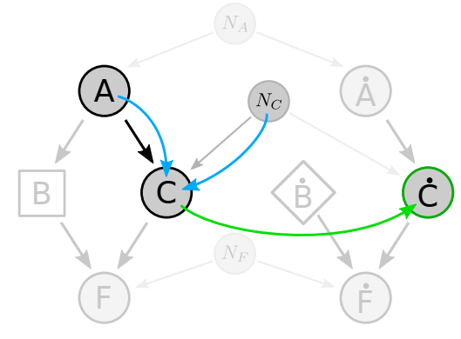
Active Machine Learning (ML) & Agency
Causality
Danmarks Tekniske Universitet
Eksamen forår 2021
02463
Alexander
Valentini
S194252

Slide 36
Active ML & Agency Causallity (Q9)
Variables & mediator
Danmarks Tekniske Universitet
Eksamen forår 2021
02463
Alexander
Valentini
S194252

Slide 37
Aktiv ML & Agency (Q9) Active learning – Variables & mediator
distinction between conditioning on a variable / making an intervention on a variable
When we intervene on a variable in a model, we fix its value. We change the system, and the values of other variables often change as a result. When we condition on a variable, we change nothing; we merely narrow our focus to the subset of cases in which the variable takes the value we are interested in. What changes, then, is our perception about the world, not the world itself.
02463
Alexander
Valentini
S194252

Slide 38
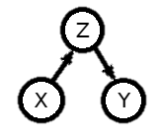
Aktiv ML & Agency (Q9) Active learning – Variables & mediator
Definition of mediator and what happens if intervention is done on it
An arrangement where variable, X, is directly causing Z, which is directly causing Y . We say X causes Y (just not directly) and we call Z a mediator.
Intervening on a mediator will break the causal relationship X and Z and the relationship
Between X and Y. Z will still cause Y. But all ancestors connections through Z are broken.
02463
Alexander
Valentini
S194252
A Friendly Introduction to Causal Inference by Jeppe Nørregaard, Lars Kai Hansen (3.2)

Slide 39
Active ML & Agency Causallity (Q10)
Interventions & collider
Danmarks Tekniske Universitet
Eksamen forår 2021
02463
Alexander
Valentini
S194252

Slide 40
Active ML & Agency (Q10) Active learning – Interventions & collider
Iow interventions are performed in randomized control trials (experiments)
Intervention: An intervention is when we forcefully set a state or process to be specifically what we want, without affecting any other part of the causal system. We show an intervention graphically by V where a variable (V) has been changed by intervention.
02463
Alexander
Valentini
S194252
A Friendly Introduction to Causal Inference by Jeppe Nørregaard, Lars Kai Hansen (section2)

Slide 41
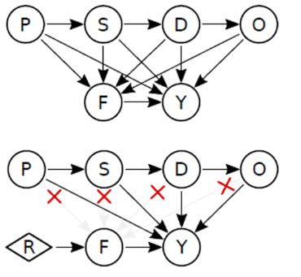
Active ML & Agency (Q10) Active learning – Interventions & collider
How interventions are performed in randomized control trials (experiments)
Randomized control trials are extremely important for scientific research as we often want to determine the effect that several values of a variable X has on Y
Instead we replace the distribution of a variable with a randomized one.
A good example is the farmer problem
02463
Alexander
Valentini
S194252
A Friendly Introduction to Causal Inference by Jeppe Nørregaard, Lars Kai Hansen (section2)

Slide 42
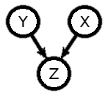
Aktiv ML & Agency (Q10) Active learning – Interventions & collider
Definition of collider and what happens when you condition on it
Collider: is composed of three causal variables, where two of them, X and Y , directly cause the third one, Z. Z thus holds information about both X and Y , while X and Y each holds some information about Z
If we know the value of two variables we can determine the third
Conditioning on a collider can create spurious correlations.
Illustrated if it denotes a coin toss (heads), and the value of the collider Z is set to 1
02463
Alexander
Valentini
S194252
A Friendly Introduction to Causal Inference by Jeppe Nørregaard, Lars Kai Hansen (3.3)

Slide 43
Active ML & Agency Causallity (Q11)
Confounder & counterfactuals
Danmarks Tekniske Universitet
Eksamen forår 2021
02463
Alexander
Valentini
S194252

Slide 44
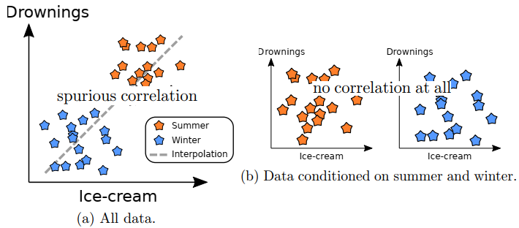
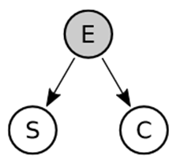
Active ML & Agency (Q11) Active learning – Confounder & counterfactuals
Definition of confounder and what happens when you condition on it
Confounder: A confounder is a variable that influences both dependent and independent variables in a statistical/causal analysis
The trouble with causality : Correlation does not imply causation
Confounders can create spurious correlations
Conditioning can solve the problem of confounders!
02463
Alexander
Valentini
S194252
A Friendly Introduction to Causal Inference by Jeppe Nørregaard, Lars Kai Hansen (1.3)

Slide 45
Active ML & Agency (Q11) Active learning – Confounder & counterfactuals
Explain the concept of counterfactuals
Counterfactual: A counterfactual questions is one where we seek information about how the world would have been different given some specific change. E.g. in a situation where X did happen, what if X had not happened
Counterfactuals thus allow us to hypothesize about alternative outcomes. E.g. counterfactual Party Time example in note 10.2
02463
Alexander
Valentini
S194252
A Friendly Introduction to Causal Inference by Jeppe Nørregaard, Lars Kai Hansen (1.3)

Slide 46
Active ML & Agency Causallity (Q12)
Causal model & mediator conditioning
Danmarks Tekniske Universitet
Eksamen forår 2021
02463
Alexander
Valentini
S194252

Slide 47
Active ML & Agency (Q12) Active learning – model & mediator conditioning
Causal model not addressed with predictive model
Predictive models simply allow us to predict the values of variables when knowing the values of other variables, not knowing the causal relationships between the variables.
Causal models enables us to infer the actual causal relationships between variables in a system.
For instance, it is possible to model and address confounders, which can otherwise create spurious correlations
Confounder: A confounder is a variable that influences both dependent and independent variables in a statistical/causal analysis
Also possible to model a mediator
In general a predictive model does not explain causes
02463
Alexander
Valentini
S194252
A Friendly Introduction to Causal Inference by Jeppe Nørregaard, Lars Kai Hansen (1.3)
https://towardsdatascience.com/be-careful-when-interpreting-predictive-models-in-search-of-causal-insights-e68626e664b6

Slide 48
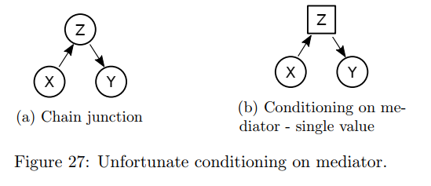
Active ML & Agency (Q12) Active learning – model & mediator conditioning
When conditioning on a mediator
Conditioning on a mediator disables our ability to see causal relationships through that mediator.
02463
Alexander
Valentini
S194252
A Friendly Introduction to Causal Inference by Jeppe Nørregaard, Lars Kai Hansen (5.3)

Slide 49
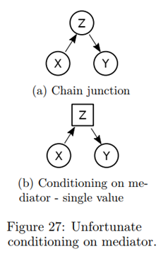
Active ML & Agency (Q12) Active learning – Confounder & counterfactuals
Consequences if you condition on a mediator
An arrangement where one variable, X, is directly causing another, Z, which is directly causing a third, Y . We also say that X causes Y (just not directly) and we call Z a mediator.
Conditioning on a mediator disables our ability to see causal relationships through that mediator.
The original causal relationship is not broken, but we cannot see it
02463
Alexander
Valentini
S194252
A Friendly Introduction to Causal Inference by Jeppe Nørregaard, Lars Kai Hansen (3.3) (5.3)

