Slide 1
Discrete probability and Bayes theorem (week1)
- Sample spaces, joint probabilities, marginals, conditionals and Bayes theorem - Classification using Naive Bayes - Images as signal (vector and matrix representations for images)
02462
Alexander
Valentini
S194252

Slide 2
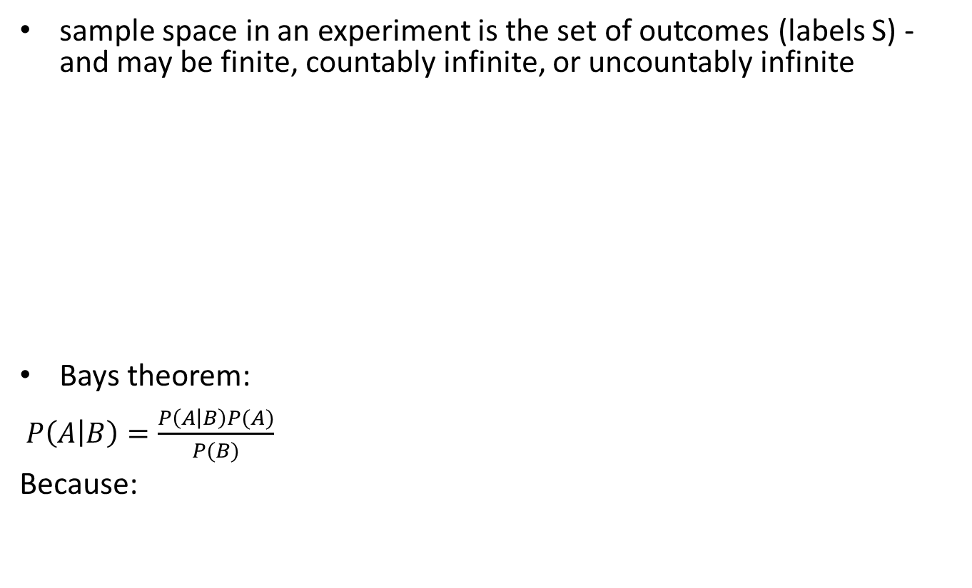
Sample spaces, joint probabilities, marginals, conditionals & Bayes theorem
sample space in an experiment is the set of outcomes (labels S) - and may be finite, countably infinite, or uncountably infinite
Bays theorem:
$P\left(A | B\right)=\frac{P\left(A | B\right)P(A)}{P(B)}$
Because:
02462
Alexander
Valentini
S194252

Slide 3
Classification using Naive Bayes
Classification with D pixels:
$$P(X_{1}=x_{1},X_{2}=x_{2},…,X_{D}=x_{D}\left|Y=1\right)$$
Assuming all pixels statistically independent (Naïve):
$$P(X_{1}=x_{1}, …,X_{D}=x_{D}\left|Y=1\right)≈\prod_{i=1}^{D}{P(X_{i}=x_{i}|Y=1)}$$
Bays theorem becomes:
$$P(Y=1|X_{1}=x_{1}, …,X_{D}=x_{D})≈\frac{\prod_{i=1}^{D}{P\left(X_{i}=x_{i} | Y=1\right)}P(Y=1)}{P(X_{1}=x_{1}, …,X_{D}=x_{D})}$$
02462
Alexander
Valentini
S194252

Slide 4
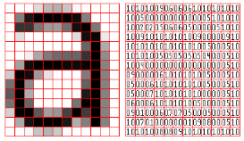
Image as signal – digitally converted
Represented as matrices
For grayscale images:
Values between 0 and 1 (intensity)
RGB channels for color images
Matrix rows stacked as a vector
We used binarized images of 28x28 pixels.
02462
Alexander
Valentini
S194252

Slide 5
Continuous probability and decision theory (week2)
- Densities, expectation, mean and variance - Normal distribution - Decision theory
02462
Alexander
Valentini
S194252

Slide 6
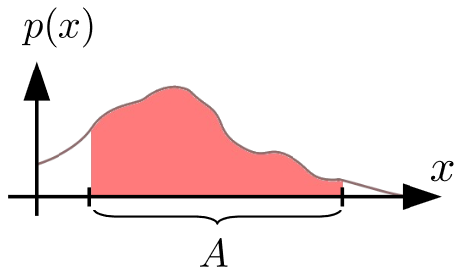
Densities
Probability of a variable being in an interval
(Relatable to mass function)
Density can be arbitrarily high, but area is always 1.
Point values are 0
02462
Alexander
Valentini
S194252

Slide 7
Expectation, mean and variance
Mean of the distribution
Variance – spread of distribution:
02462
Alexander
Valentini
S194252

Slide 8
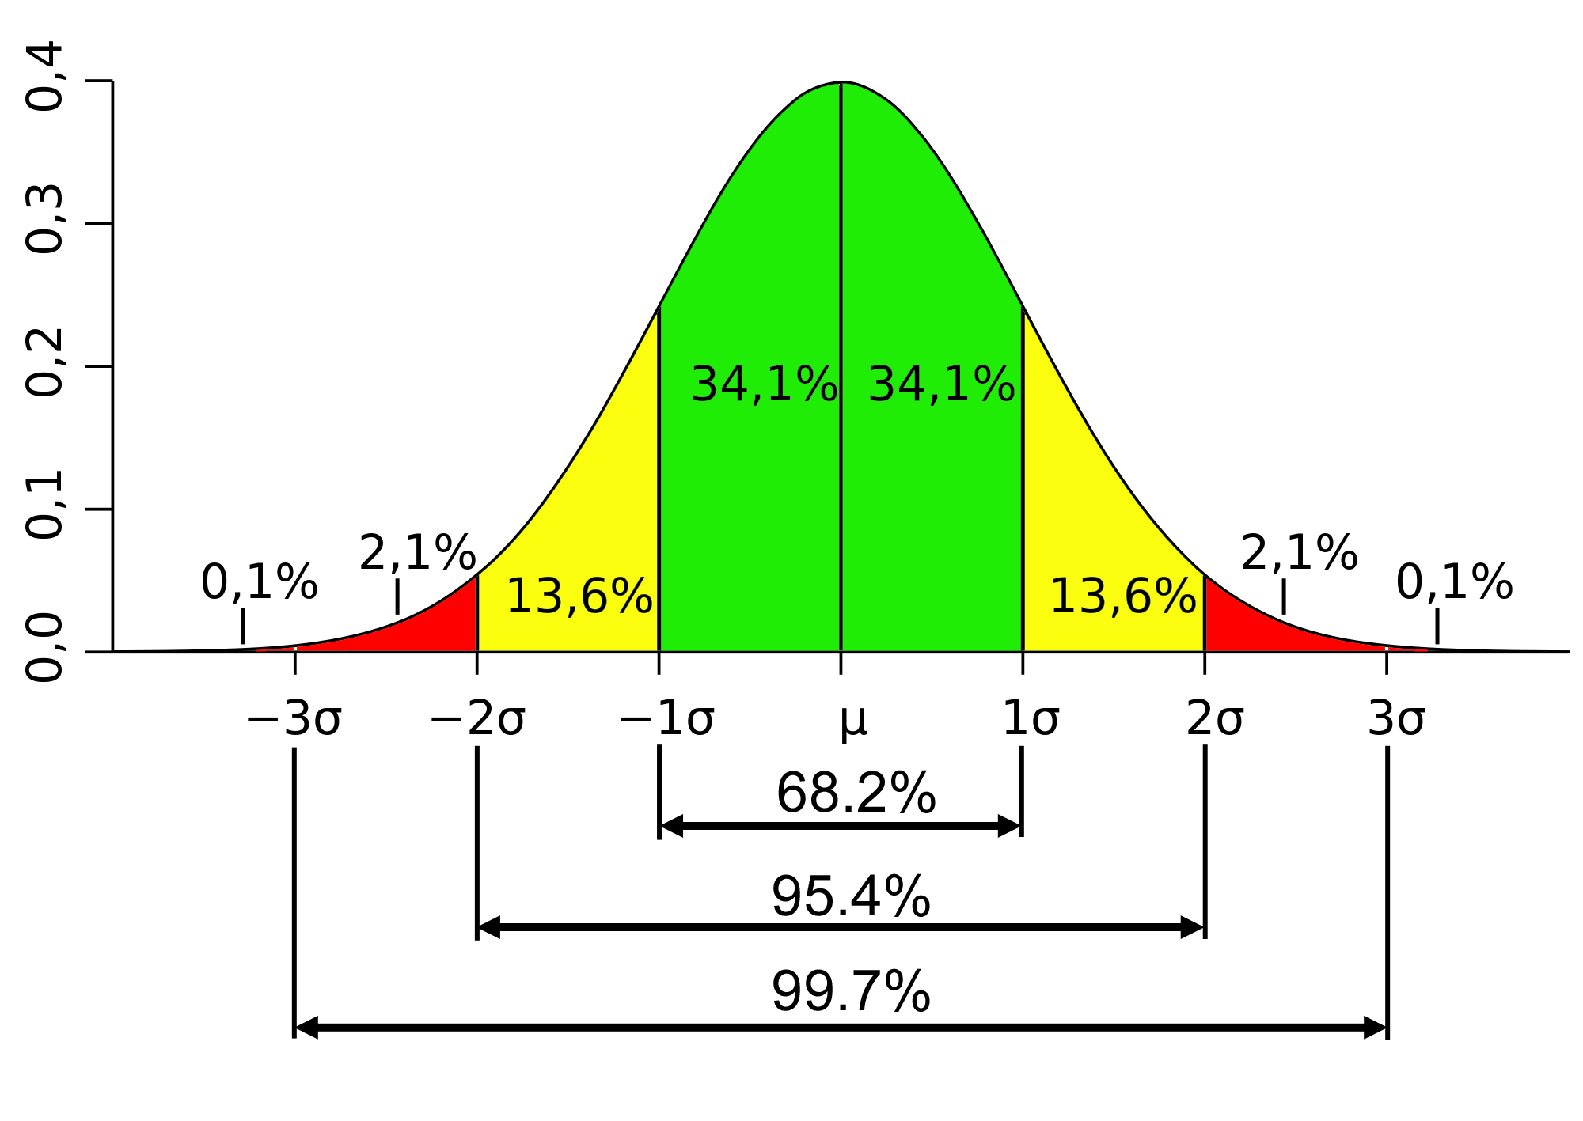
Normal distribution and its properties
Follows the formula:
Normal plus normal:
Location scale family:
Fit to data with mean and variance
”Almost everything is almost normal” - if N is large enough
02462
Alexander
Valentini
S194252

Slide 9
Decision theory
Decision function
Zero one example
Calculate expectation of indicator function:
Tumor example:
Linear function depending on utility
02462
Alexander
Valentini
S194252

Slide 10
Models and inference (week3)
- Maximum likelihood, maximum a posteriori (MAP) and Bayesian inference - Maximum likelihood estimators of the parameters for the normal distribution - Binomial distribution for estimating proportions
02462
Alexander
Valentini
S194252

Slide 11
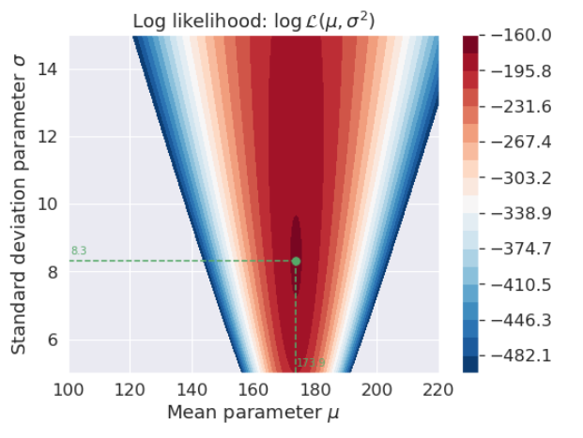
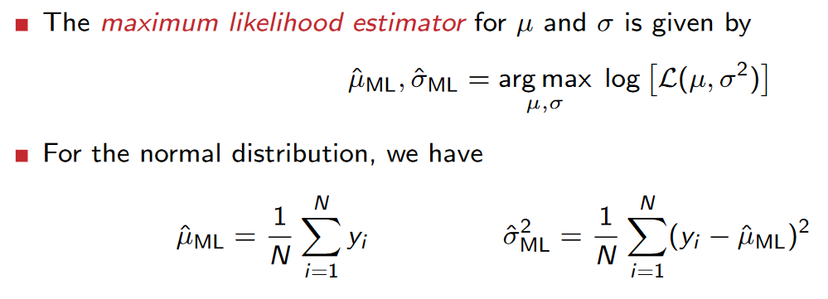
Maximum likelihood estimators of the parameters for the normal distribution
How do we estimate $μ$ and $σ$?
Choose model – fit model to data:
Differentiate and set to 0
02462
Alexander
Valentini
S194252

Slide 12
Binomial distribution
Probability function
Used to estimate proportions
Take log of both sides, set derivative of $θ$ to 0:
log$ℒ\left(θ\right)=\log\left[\frac{N!}{k!\left(N−k\right)!}\right]+\left(N−k\right)\log\left(1−θ\right)+k∙log(θ$)
Binomial coefficient:
$$θ_{ML}=\frac{k}{N}$$
02462
Alexander
Valentini
S194252

Slide 13
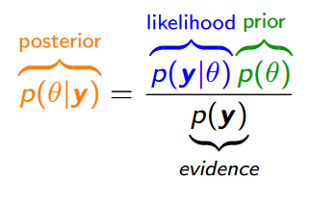
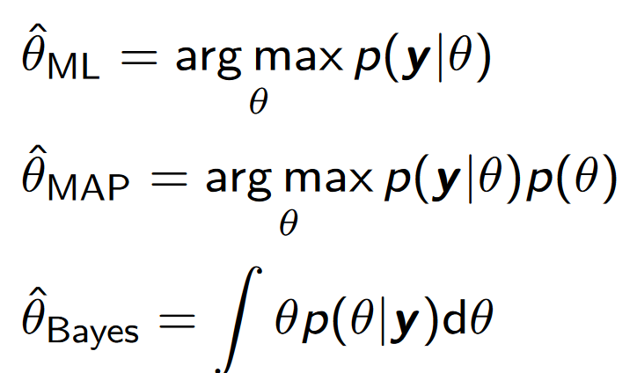
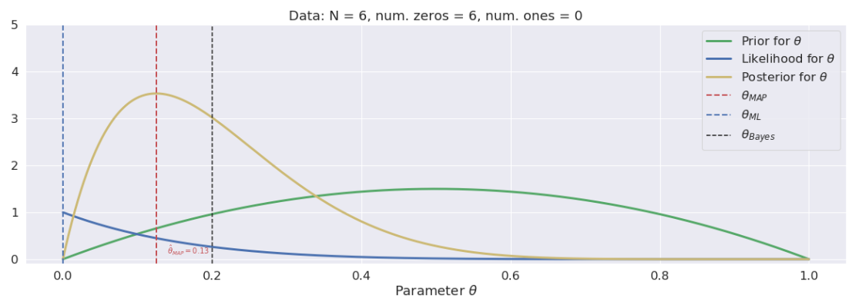
ML, MAP and Bayes
Incorporating prior knowledge
Evidence only depends on y - does not change optimal $θ$
Data trumpfs prior with large N
02462
Alexander
Valentini
S194252

Slide 14
Multivariate normal and linear transformations (week4)
- Covariance and correlation - Multivariate normal distribution - Linear transformations (rotation, scaling and translation)
02462
Alexander
Valentini
S194252

Slide 15
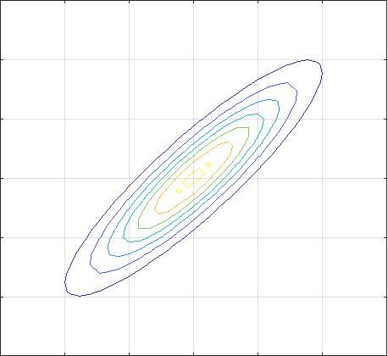
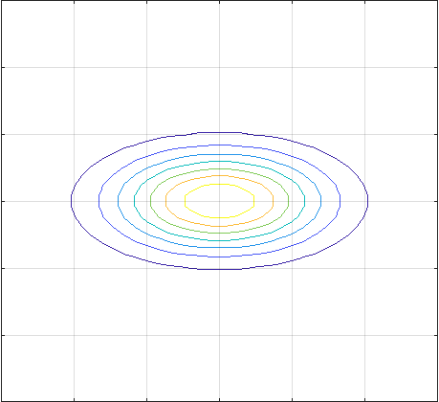
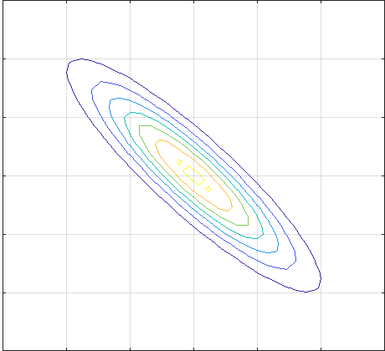
Covariance and correlation
Covariance for 2 variables X,Y measures dependency:
$$cov\left(X,Y\right)=E\left[\left(X−E\left(X\right)\right)\left(Y−E\left(Y\right)\right)\right]=E\left[XY\right]−E\left[X\right]E[Y]$$
Variance for 1 variable:
$$var\left[X\right]=cov(X,X)$$
Correlation for 2 variables X,Y measures influence:
$$corr\left(X,Y\right)=\frac{cov\left(X,Y\right)}{\sqrt{var\left[X\right]var[Y]}}$$
Normalized measure of covariance in interval [1,-1]. 0 if independent
$$cov\left(X,Y\right)>0$$
$$cov\left(X,Y\right)=0$$
$$cov\left(X,Y\right)<0$$
02462
Alexander
Valentini
S194252

Slide 16
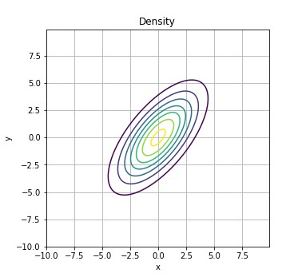
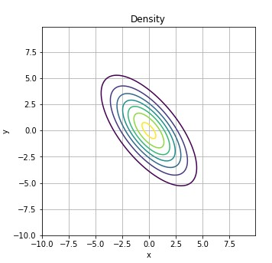
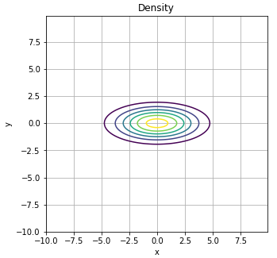
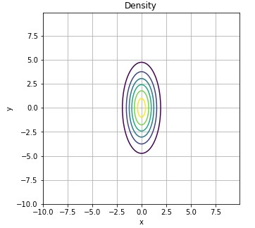
Multivariate normal distribution
Covariance matrix
$Σ=\left[\begin{matrix}\begin{matrix}\begin{matrix}var[X_{1}] \\ cov[X_{1},X_{2}] \\ \begin{matrix}… \\ cov\left[X_{D},X_{1}\right]\end{matrix}\end{matrix} & \begin{matrix}cov[X_{1},X_{2}] \\ var[X_{2}] \\ \begin{matrix}… \\ cov\left[X_{D},X_{2}\right]\end{matrix}\end{matrix}\end{matrix} & \begin{matrix}… \\ … \\ \begin{matrix}… \\ …\end{matrix}\end{matrix} & \begin{matrix}cov[X_{1},X_{D}] \\ cov[X_{2},X_{D}] \\ \begin{matrix}… \\ var[X_{D}]\end{matrix}\end{matrix}\end{matrix}\right]$ =
Multivariate normal distribution
$$ℵ\left(x | μ,Σ\right)=\frac{1}{\sqrt{{\left(2π\right)}^{D}det⁡(Σ)}}exp⁡(−\frac{1}{2}{\left(x−μ\right)}^{T}Σ^{−1}(x−μ))$$
Where $Σ$ is covariance matrix and $μ$ is vector with means.
$$Σ=\left[\begin{matrix}5 & 4 \\ 4 & 7\end{matrix}\right]$$
$$Σ=\left[\begin{matrix}5 & −4 \\ −4 & 7\end{matrix}\right]$$
$$Σ=\left[\begin{matrix}6 & 0 \\ 0 & 1\end{matrix}\right]$$
$$Σ=\left[\begin{matrix}1 & 0 \\ 0 & 6\end{matrix}\right]$$
02462
Alexander
Valentini
S194252

Slide 17
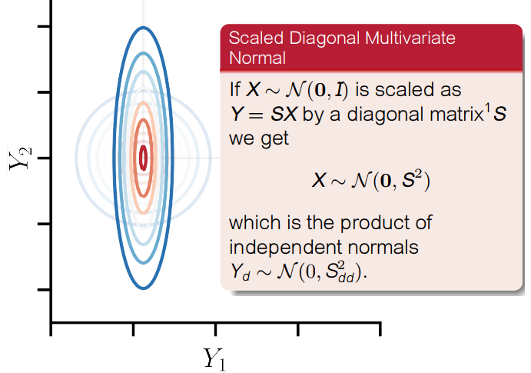
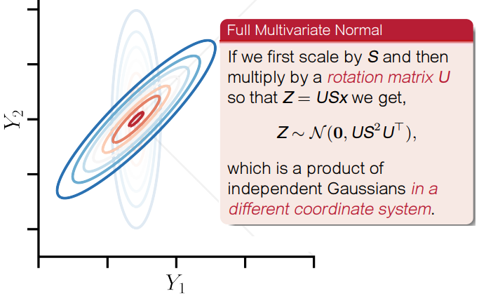
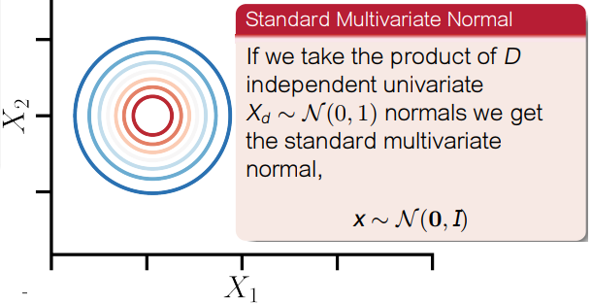
Linear transformations (rotation, scaling and translation)
02462
Alexander
Valentini
S194252

Slide 18
PCA and image filtering (week5)
- Principal component analysis - Dimensionality reduction and visualization - Image filtering and convolution
02462
Alexander
Valentini
S194252

Slide 19
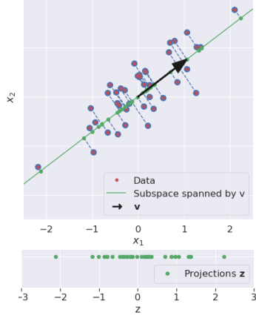
Principal component analysis
Goal: Project data to subspace that maximizes variance.
Unit basis: $v_{i}^{T}v_{j}=\left\{\begin{matrix}1,i =j \\ 0,i≠j\end{matrix}\right.$
$z_{n}=v^{T}x_{n}$, $Z=v^{T}X$ $σ_{z}^{2}=v^{T}\left(\frac{1}{N}\sum_{n=1}^{N}{\left(x_{n}−{\hat{μ}}_{x}\right){\left(x_{n}−{\hat{μ}}_{x}\right)}^{T}}\right)v=v^{T}{\hat{C}}_{x}v$
Lagrange multiplier:
v to m$aximize σ_{z}^{2}$, optimize: $J\left(v\right)=v^{T}{\hat{C}}_{x}v−λ\left(1−v^{T}v\right)$
$0=\frac{δ}{δv}J\left(v\right)={2v}^{T}C_{x}−2λv^{T}$, $0=\frac{δ}{δλ}J\left(v\right)=1−v^{T}v$
V is a unit eigenvector of $C_{x}$
02462
Alexander
Valentini
S194252

Slide 20
Principal component projection
Step 1: compute mean ${\hat{μ}}_{x}=\frac{1}{N}\sum_{i=1}^{N}{x_{i}}$
Step 2: compute covariance ${\hat{C}}_{x}=\frac{1}{N}\sum_{n=1}^{N}{\left(x_{n}−{\hat{μ}}_{x}\right){\left(x_{n}−{\hat{μ}}_{x}\right)}^{T}}$
Step 3: compute eigenvectors $v_{i}$and eigenvalues $λ_{i}$ for ${\hat{C}}_{x}=VDV^{T}$, $D=diag\left(λ_{i}\right)$
Step 4: project to principal components: $z_{i}=V^{T}(x_{i}−\hat{μ})$
02462
Alexander
Valentini
S194252

Slide 21
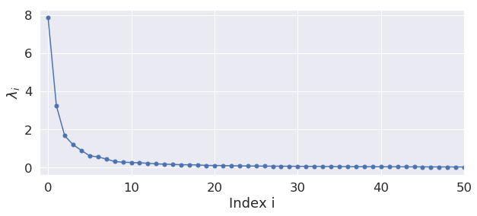
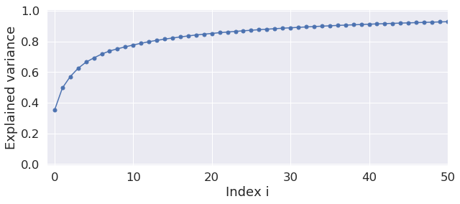
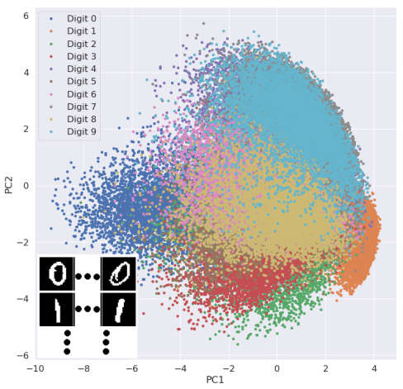
Dimensionality reduction and visualization
$λ_{i}=$ is the variance of the data along the i’th principal component
$T=\sum_{i=1}^{D}{λ_{i}=}$total variance of the data $E(M)=\frac{1}{T}\sum_{i=1}^{M}{λ_{i}=}$ fraction of explained variance
First 10x $λ_{i}$ usually accounts for 80%
Visualize by projecting onto two principal components
02462
Alexander
Valentini
S194252

Slide 22
Image processing
Pixelwise mapping, output only depend on input: $f_{out}\left(x,y\right)=$F($f_{in}\left(x,y\right)$)
Convolutional filter, output found from window: $f_{out}\left(x,y\right)=$F(${\{f}_{in}\left(u,v\right),u,v|(u,v)∈W(x,y)$})
Geometric transformation, output depends on input and position: $f_{out}\left(x,y\right)=$F($f_{in}\left(u,v\right),u,v$)
Boundary conditions : Valid, output image is smaller than input image - Fixed boundary, boundary is padded with a fixed value (commonly zeros) - Reflection, boundary rows/columns are mirrored to create padding
02462
Alexander
Valentini
S194252

Slide 23
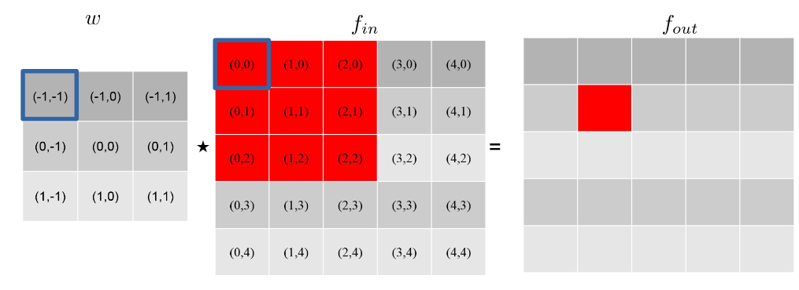
Image filtering and convolution
Cross-relation
$$f_{out}\left(x,y\right)=w\left(s,t\right)⋆f_{in}\left(x,y\right)=\sum_{s=−a}^{a}{\sum_{t=−b}^{b}{w\left(s,t\right)f_{in}(x+s,y+t)}}$$
Convolution
$$f_{out}\left(x,y\right)=w\left(s,t\right)∗f_{in}\left(x,y\right)=\sum_{s=−a}^{a}{\sum_{t=−b}^{b}{w\left(s,t\right)f_{in}(x−s,y−t)}}$$
02462
Alexander
Valentini
S194252

Slide 24
Boundary Conditions
Boundary conditions : Valid, output image is smaller than input image - Fixed boundary, boundary is padded with a fixed value (commonly zeros) - Reflection, boundary rows/columns are mirrored to create padding
02462
Alexander
Valentini
S194252

Slide 25
Time-series and signal processing (week6)
- Time-series as signal (vector representations for time-series), sampling and aliasing - Harmonic basis functions - Frequency representations
02462
Alexander
Valentini
S194252

Slide 26
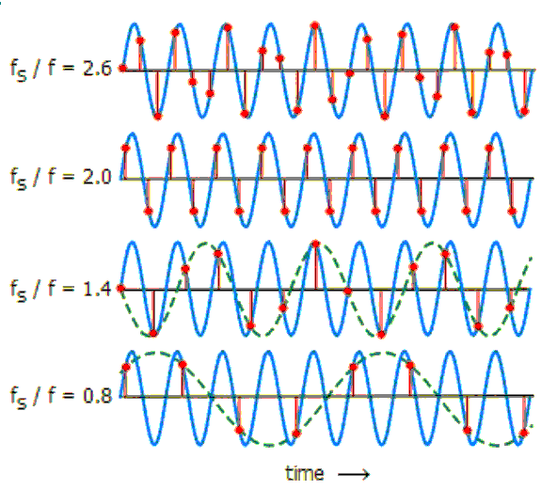
Time signal as vector representation
Discrete signal $y_{d}(n)$ from continuous signal $y_{a}(t)$: from time domain to discrete interval
$y_{a}\left(t\right)⟶y_{d}\left(n\right)=y_{a}\left(\frac{n}{f_{s}}\right)$, $f_{s}$=samp.freq.
Low samp.freq. $⟶$aliasing
Reconstruction possible: $\frac{f_{s}}{f}≥2$
(Nyquest rate)
02462
Alexander
Valentini
S194252

Slide 27
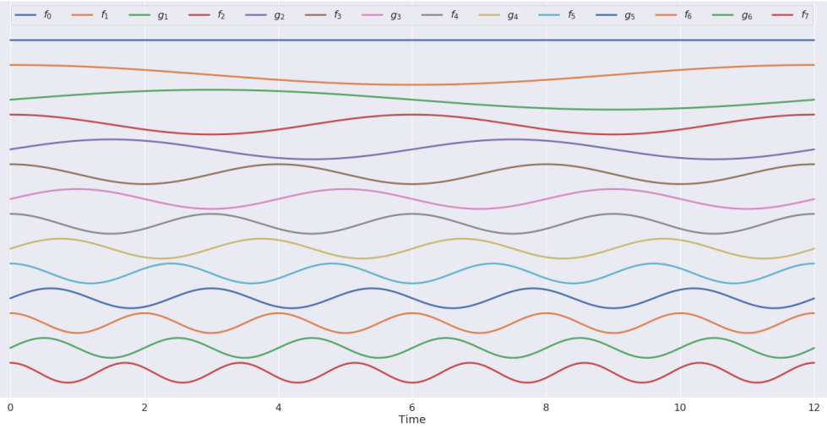
Harmonic basis functions
Used for frequency analysis
Need discrete sequence basis:
$y=[y_{0},y_{1},y_{2},..,y_{N−1}]$
Requires N = 1 + 2K basis functions $f_{0},f_{1},f_{2},..,f_{N}$ where k=1,2,..,K and K=(N-1)/2
$$f_{0}\left(n\right)=1,f_{k}\left(n\right)=cos⁡(2π\frac{k}{N}n),g_{k}\left(n\right)=sin⁡(2π\frac{k}{N}n)$$
Unit basis: $v_{i}^{T}v_{j}=\left\{\begin{matrix}1,i =j \\ 0,i≠j\end{matrix}\right.$
$V=\frac{1}{\sqrt{N}}{\left[\begin{matrix}1 \\ \sqrt{2}\cos\left(t\right) \\ \begin{matrix}\sqrt{2}\sin\left(t\right) \\ \sqrt{2}\cos\left(2t\right) \\ \begin{matrix}\sqrt{2}\sin\left(2t\right) \\ … \\ \begin{matrix}\sqrt{2}\cos\left(Kt\right) \\ \sqrt{2}\sin\left(Kt\right)\end{matrix}\end{matrix}\end{matrix}\end{matrix}\right]}^{T}$
$\text{t} \text{=} \frac{2π}{N}\left[0,1,2,..,N−1\right]$, $K=\frac{N−1}{2}$
02462
Alexander
Valentini
S194252

Slide 28
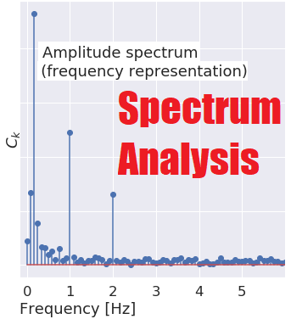
Frequency representations
Measures similarity between y and harmonic basis functions
z =
${z=v}^{T}y$, y =$vz=\frac{1}{\sqrt{N}}{\left[\begin{matrix}1 \\ \sqrt{2}\cos\left(t\right) \\ \begin{matrix}\sqrt{2}\sin\left(t\right) \\ \sqrt{2}\cos\left(2t\right) \\ \begin{matrix}\sqrt{2}\sin\left(2t\right) \\ … \\ \begin{matrix}\sqrt{2}\cos\left(Kt\right) \\ \sqrt{2}\sin\left(Kt\right)\end{matrix}\end{matrix}\end{matrix}\end{matrix}\right]}^{T}$ $\left[\begin{matrix}a_{0} \\ a_{1} \\ \begin{matrix}b_{1} \\ a_{2} \\ \begin{matrix}b_{2} \\ … \\ \begin{matrix}a_{K} \\ b_{K}\end{matrix}\end{matrix}\end{matrix}\end{matrix}\right]$ ,
$y\left(n\right)=a_{0}+\sum_{k=1}^{K}{\left(a_{k}\cos\left(2π\frac{k}{N}n\right)+b_{k}\sin\left(2π\frac{k}{N}n\right)\right)}$
$$=a_{0}+\sum_{k=1}^{K}{c_{k}\cos\left(2π\frac{k}{N}n+φ_{k}\right)},c_{k}=\sqrt{a_{k}^{2}+b_{k}^{2}}\text{, }\text{tan}\text{(}φ_{k})=\frac{a_{k}}{b_{k}}$$
$c_{k}$ is amplitude spectrum and $φ_{k}$ is
phase spectrum, $f_{analysis}\left(k\right)=k\frac{f_{s}}{N}$
02462
Alexander
Valentini
S194252

Slide 29
Audio and filtering (week7)
- Audio as signal (vector representations for audio) - Spectrograms - Filtering in the time and frequency domain
02462
Alexander
Valentini
S194252

Slide 30
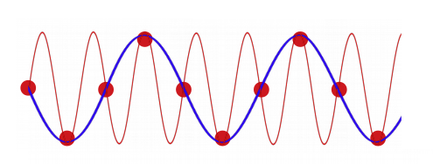
Audio signal as vector representation
Air pressure – amplitude over time Discrete signal $y_{d}(n)$ from continuous signal $y_{a}(t)$: from time domain to discrete interval:
$y_{d}\left(n\right)⟶y_{a}\left(t\right), y_{d}\left(n\right)=y_{a}\left(\frac{n}{f_{s}}\right)$, $f_{s}$=samp.freq.
Low samp.freq. can cause aliasing
Frequency representation helps: Analyze and understand the signal - Denoise signals (filtering) - Extract relevant features
02462
Alexander
Valentini
S194252

Slide 31
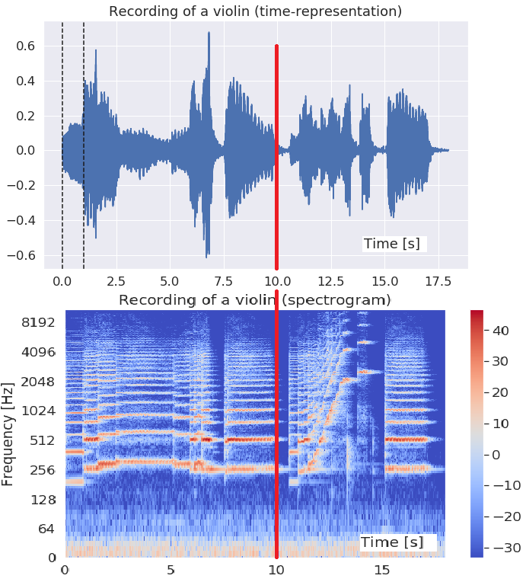
Spectrograms
Analysis of frequency content
STFT: Short-time Fourier transformation is a standard tool for computing spectrograms
Analyse frequency content for small time windows
Continuous spectrum by overlapping
02462
Alexander
Valentini
S194252

Slide 32
Filters
Used to remove noise
Low pass filter - keeps low frequency content
High pass filter - keeps high frequency content
Band-pass filter - keeps content in freq. interval
Band-stop filter - attenuates freqs. inside interval and keeps the rest
02462
Alexander
Valentini
S194252

Slide 33
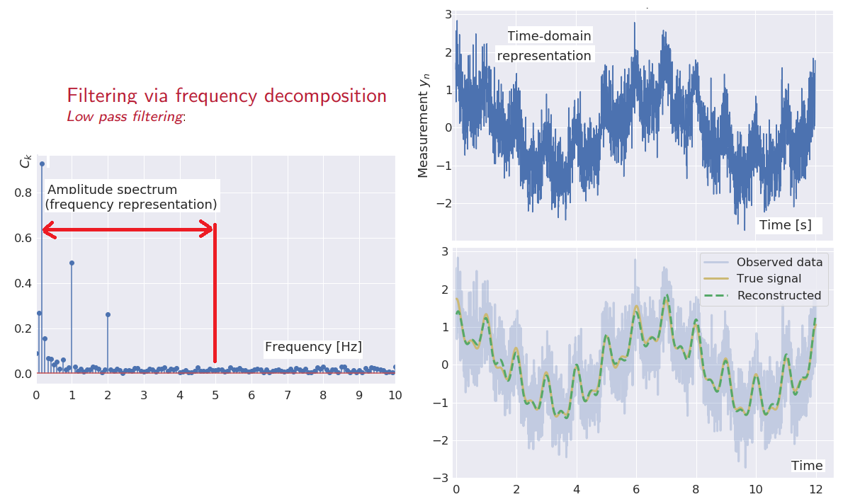
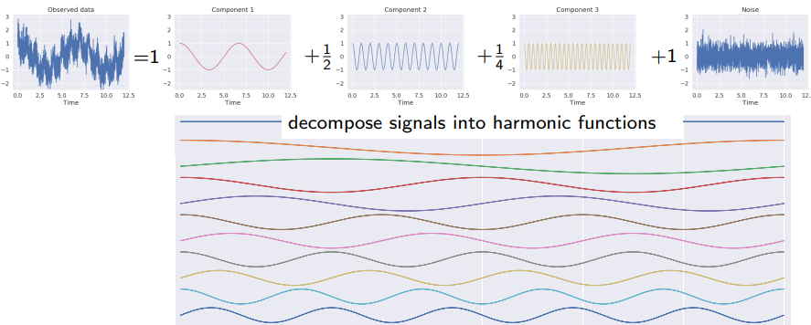
Filtering:frequency domain
Filtering frequency and harmonics
Set filtered k values to 0.
02462
Alexander
Valentini
S194252

Slide 34
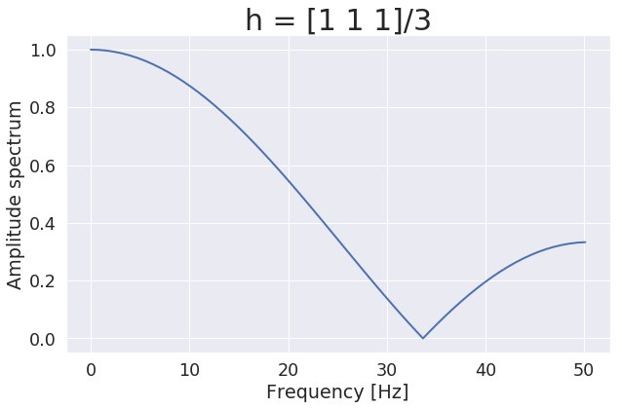
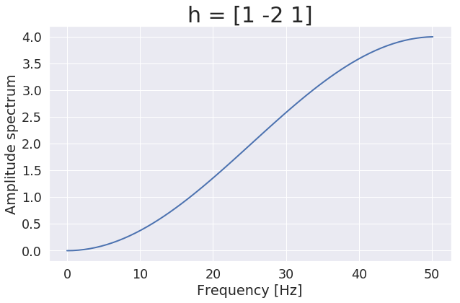
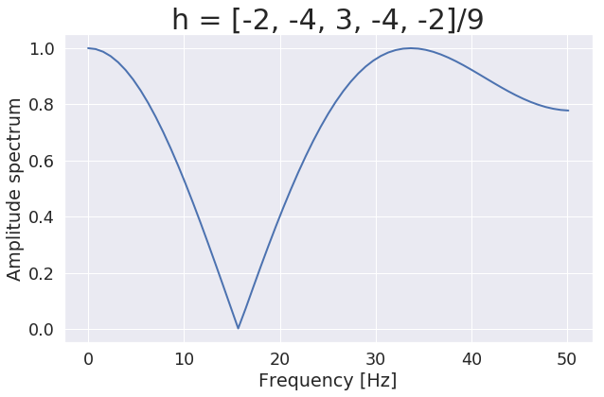
Filtering: Time domain
Convolution to filter time-series signals:
Analyzing the filters: frequence response
$h_{smooth}=\frac{1}{3}[1, 1, 1]$
$$h_{edge}=[1, −2, 1]$$
Filters can be analysed by
zero-padding and frequency content
02462
Alexander
Valentini
S194252

Slide 35
Text and bag-of-words representations (week8)
- Text as signal and bag-of-words representations - Latent semantic analysis - Sentiment analysis
02462
Alexander
Valentini
S194252

Slide 36
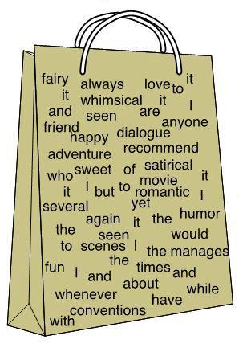
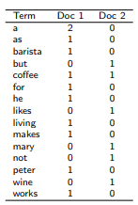
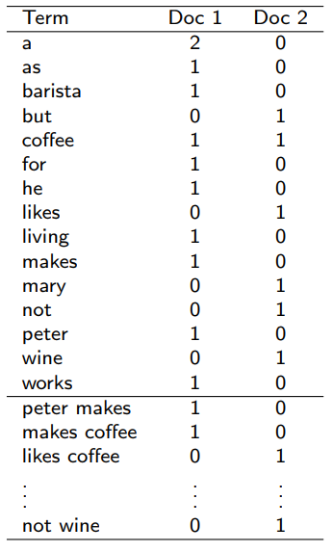
Text as signal and bag-of-words representations
Vector representation of text
Sentences & words vary in length
Representation to apply existing ML tools
Assumption: Grammar and word order does not matter
Construct vocabulary of words in texts
Can be extended with n-grams to capture some context
Expensive to use N-grams
Number of unigrams $O$(V ): V = 1000 Number of bigrams ${O(V}^{2}):{ V}^{2}={1000}^{2}={10}^{6}$ Number of trigrams ${O(V}^{3}):{ V}^{3}={1000}^{3}={10}^{9}$ Number of ngrams ${O(V}^{n}):{ V}^{n}={1000}^{n}=$ ${10}^{3n}$
02462
Alexander
Valentini
S194252

Slide 37
Bag-of-words models
Model 1: categorizing in term-document-matrix and vocabulary
Model 2: analyze n-gram representations
Model 3: analyze vocubulary size V: Number of unigrams $O$(V ): V = 1000 Number of bigrams ${O(V}^{2}):{ V}^{2}={1000}^{2}={10}^{6}$ Number of trigrams ${O(V}^{3}):{ V}^{3}={1000}^{3}={10}^{9}$ Number of ngrams ${O(V}^{n}):{ V}^{n}={1000}^{n}=$ ${10}^{3n}$
02462
Alexander
Valentini
S194252

Slide 38
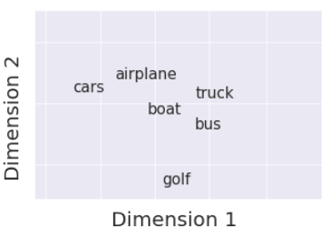
Latent semantic analysis (LSA)
Latent semantic analysis (LSA) analyze relationships between documents and words. LSA provides vector representations for documents & words
Bag-of-words matrix is a matrix A where $a_{ij}$=number of times the i'th word in the vocabulary occurs in the j'th document
Calculate term-by-term matrix, $B=AA^{T}$, and document-by-document matrix, $C=A^{T}A$. The B matrix is sometimes also known as the co-occurence matrix is the second order moment
How often do words occur in same document, and how many words do documents share
Related to the empirical covariance matrices.
PCA on B (for texts) and C (for words) creates latent spaces
02462
Alexander
Valentini
S194252

Slide 39
LSA – cluster relationships
Example with texts from Exercise 8 about image classification and neural scan
02462
Alexander
Valentini
S194252

Slide 40
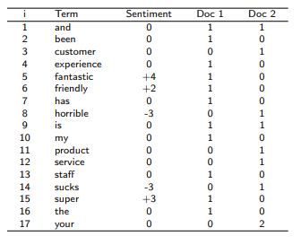
Sentiment analysis
Sentiment analysis is extracts and classify emotions and sentiments in text data
Sentiment: Is the document positive or negative?
Arousal: How emotional is the document? Let $s_{k}$ be the word sentiment score for the k’th word, then the text sentiment score S and the text arousal score A are given by
$S=\sum_{k=1}^{K}{s_{k}}$, $A=\sum_{k=1}^{K}{\left|s_{k}\right|}$
Done efficiently as inner product between bag of words matrix x and sentiment score vector s :
$$x=\left[x_{1},x_{2},..,x_{V}\right], s=\left[s_{1},s_{2},..,s_{V}\right]$$
$S=\sum_{i=1}^{V}{{x_{i}s}_{i}=x^{T}s}$, $A=\sum_{i=1}^{V}{x_{i}\left|s_{i}\right|=x^{T}\tilde{s}}$
02462
Alexander
Valentini
S194252

Slide 41
Word embeddings and visualization (week9)
- Word embeddings and GloVe vectors - Visualizing word embeddings with PCA - Bias in data
02462
Alexander
Valentini
S194252

Slide 42
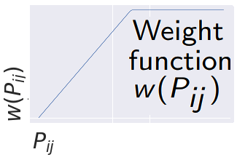
Word embeddings & GloVe vectors
GloVe use co-occurence matrix, not bag-of-words
Co-occurrence matrix X: $X_{ij}$=how often word j occurs in context of word i
Co-occurrence probability matrix P:
$P_{ij}=P\left[word j | word i\right]=\frac{P[word j,word i] }{P[word i] }=\frac{X_{ij}}{X_{i}},$ $X_{i}=\sum_{k}{X_{ik}}$
Minimizing cost function for word matrices V,U:
$J=\sum_{i,j}{w\left(P_{ij}\right){[g\left(u_{i},v_{j}\right)−log{(P}_{ij})]}^{2},g\left(u_{i},v_{j}\right)=u_{i}^{T}v_{j}}$
dimensionality D for the word vectors &
$X∈ℝ^{V×V}$ - $U∈ℝ^{D×V}$ - $V∈ℝ^{D×V}$
02462
Alexander
Valentini
S194252

Slide 43
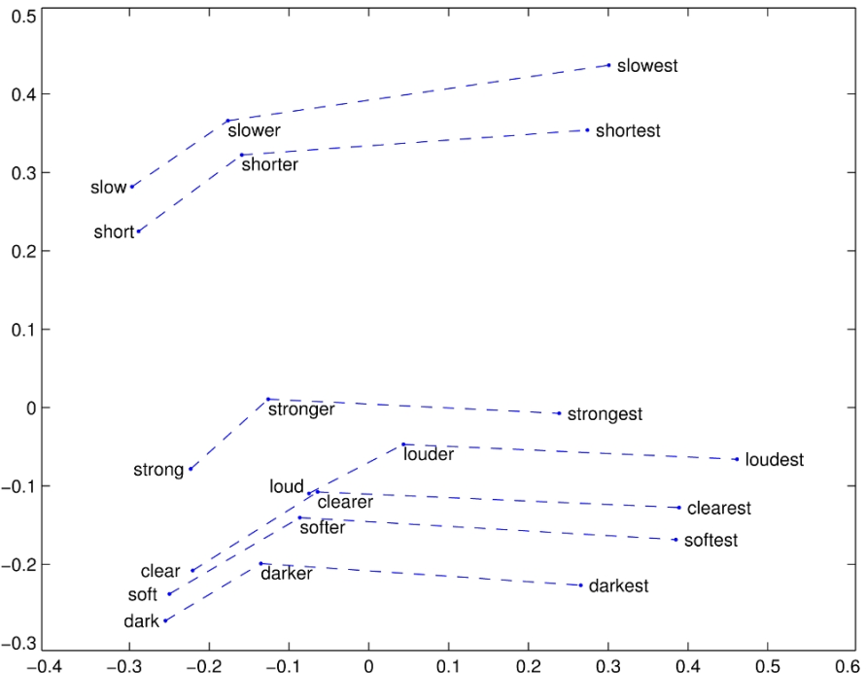
Visualizing word embeddings with PCA
Using the Glove method, we obtain D-dimensional vectors for each word
Dimension D is usually 10-1000 & we PCA may reduce dimension to 2D for visualization
Some features are likely to have some interpretation (ex. gender, family ties)
Word analogies and cosine distance
02462
Alexander
Valentini
S194252

Slide 44
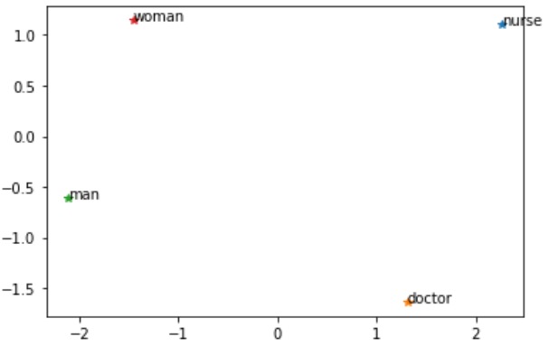
Bias in data
Word embeddings inherit implicit bias in the corpus – about gender, family, race etc
Evaluating word embeddings analogies will reveal bias.
02462
Alexander
Valentini
S194252

Slide 45
PCA for visualization and transfer learning (week10)
- PCA for visualizing latent variables representations in neural networks - Linear classifiers and the softmax function - Transfer learning
02462
Alexander
Valentini
S194252

Slide 46
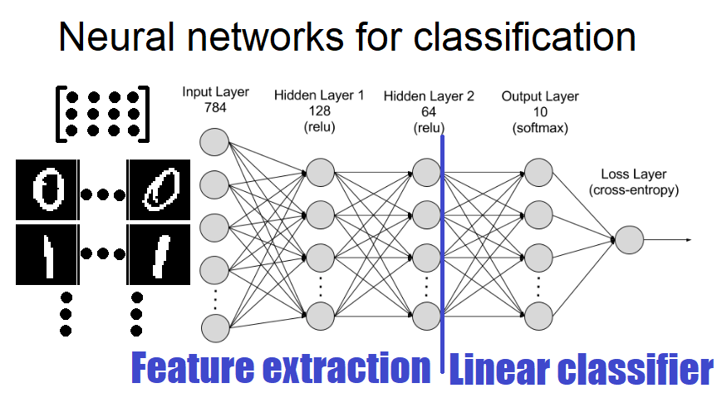
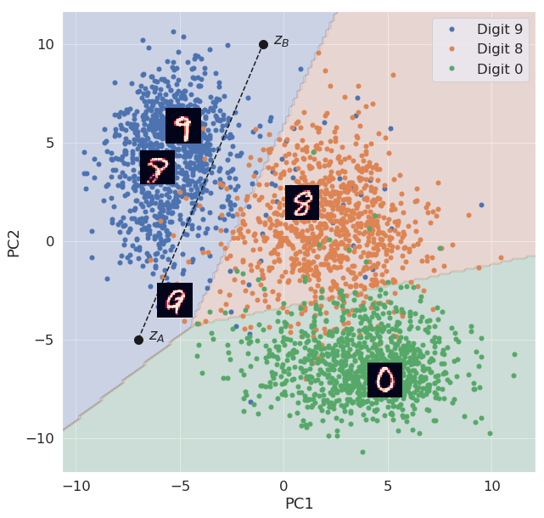
PCA data visualizing
2-layer network training with Neural Networks as Feature Extraction + Linear Classifier
Perform PCA on output of Feature Extraction
02462
Alexander
Valentini
S194252

Slide 47
Softmax function for Linear classifiers
Prediction on linear combined input feature: $a_{k}\left(x\right)=w_{K}^{T}x$, $\hat{y}\left(x\right)=arg \max_{k}$ $a_{k}\left(x\right)$
Probalistic Softmax transformation: $P\left(y=k\right|x)=\frac{exp⁡(a_{k}\left(x\right))}{\sum_{i=1}^{K}{exp⁡(a_{i}\left(x\right))}}$
Most likely: $arg \max_{k} P\left(y=k\right|x)=arg \max_{k}\frac{exp⁡(a_{k}\left(x\right))}{\sum_{i=1}^{K}{exp⁡(a_{i}\left(x\right))}}=arg \max_{k} a_{k}\left(x\right)=\hat{y}\left(x\right)$
02462
Alexander
Valentini
S194252

Slide 48
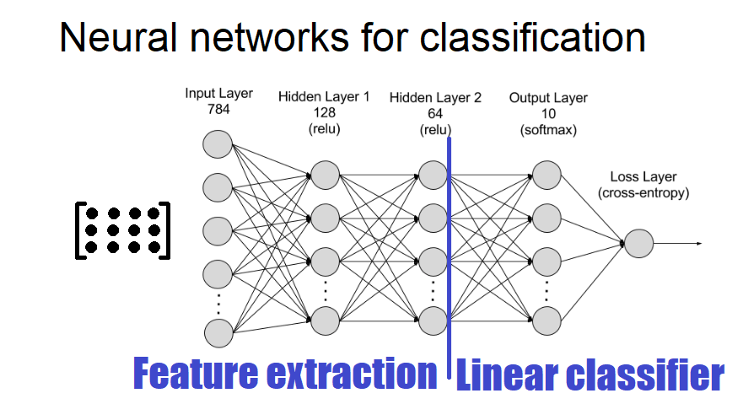
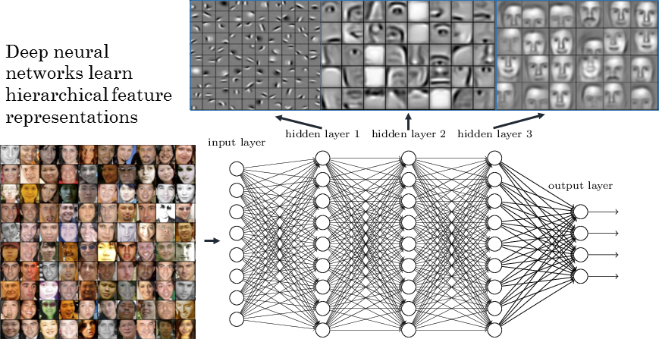
Transfer learning
Training network on dataset and using learned feature extraction part on another datasets… is transfer learning
Reduce training + improve performance (especially on small datasets)
Use pre-trained Network (on similar task if possible)
Freeze Feature Extraction, train new Linear Classifier
Unfreeze, fine tune entire Network with small learning rate from previous weights
02462
Alexander
Valentini
S194252

